Slide 1
Arrays Advanced
Additional Array Operations
0
1
2
3
4
…
…
…
…
…
SoftUni Team
Technical Trainers
Software University
https://softuni.bg

Slide 2
Table of Contents
Basic Operations
Manipulating Arrays
Processing Elements
Transform (Map)
Filter
Sort

Slide 3
Have a Question?
sli.do
#fund-js

Slide 4
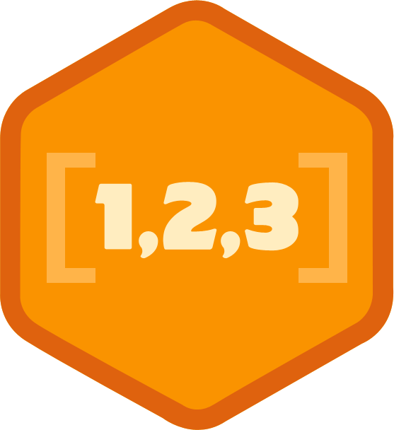
Basic Operations
Add, Remove and Find Elements

Slide 5
Advanced Overview
Advanced functionality of the array consists of the following functions:
push() – add to the end
pop() – remove from the end
unshift() – add to the beginning
shift() – remove from the beginning
includes() – look for value
indexOf() – find index of value

Slide 6
Add at the End, Remove from the End
push() adds at the end of the array
pop() removes from the end of the array
10
Array
Use push() to add at the end.
20
30
Use pop() to remove from the end.

Slide 7
Add at the Start, Remove from the Start
unshift() adds at the start of the array
shift() removes from the start of the array
Array
Use shift() to remove from the start.
20
10
20
Use unshift(20) to add at the start.
30

Slide 8
Pop() – Removes the Last Element
The pop method removes the last element from an array and returns that value to the caller
If you call pop() on an empty array, it returns undefined
let myArray = ["one","two","three","four","five"];
let popped = myArray.pop();
console.log(myArray); //["one","two","three","four"]
console.log(popped); //"five"

Slide 9
Problem: Sum First Last
Calculate and print the sum of the first and the last elements in an array
The input comes as array of string elements holding numbers
The output is the return value of your function
['5' , '10']
15
function solve(input) {
input = input.map(Number);
console.log(input[0]
+ input.pop());
}
['20', '30', '40']
60

Slide 10
Pushing into Array
The push method adds one or more elements to the end of an array and returns the new length
let fruits = ["apple","banana","kiwi"];
fruits.push("pineapple");
console.log(fruits); // ["apple","banana","kiwi","pineapple"]
Element is added at the end

Slide 11
Shifting and Unshifting
shift() - Removes the first element of an array
unshift() - Adds elements to the beginning
let myArray = ["one","two","three","four","five"];
myArray.shift(); // ["two","three","four","five"]
let myArray = ["red","green","blue"];
myArray.unshift("purple");
// ["purple","red","green","blue"]
New element added

Slide 12
Problem: Negative / Positive Numbers
You are given an array of numbers arr
Process them one by one and produce a new array result
Prepend each negative element at the front of result
Append each positive (or 0) element at the end of result
Print the result array, each element at separate line
7
-2
8
9
-2
7
8
9
3
-2
0
-1
-1
-2
3
0
-3
2
-1
0
-1
-3
2
0

Slide 13
Solution: Negative / Positive Numbers
function negativePositiveNumbers(arr) {
let result = [];
for (let num of arr){
if (num < 0){
result.unshift(num); // Insert at the start
} else {
result.push(num); // Append at the end
}
console.log(result.join('\n'));
}
}

Slide 14
Find Values
includes() – returns true if the given value is part of the array
indexOf() – returns the index where the given value is stored
Returns -1 if value is not found
let myArray = ["Peter","George","Mary"];
myArray.includes("George"); // true
myArray.includes("John"); // false
myArray.indexOf("Mary"); // 2
myArray.indexOf("Nick"); // -1

Slide 15
Manipulating Arrays
…
…
…
…
…
#
…
…
…

Slide 16
Slicing Arrays
The slice() function creates new array from part of another
Gets a range of elements from selected start to end (exclusive)
Note that the original array will not be modified
let myArray = ["one","two","three","four","five"];
let sliced = myArray.slice(2);
console.log(myArray); //["one","two","three","four","five"]
console.log(sliced); // ["three","four","five"]
console.log(myArray.slice(2,4)); // ["three","four"]

Slide 17
Splice: Cut and Insert Array Elements
The splice() adds/removes items to/from an array, and returns the removed item(s)
This function changes the original array
let nums = [5, 10, 15, 20, 25, 30];
let mid = nums.splice(2, 3); // start, delete-count
console.log(mid.join('|')); // 15|20|25
console.log(nums.join('|')); // 5|10|30
nums.splice(3, 2, "twenty", "twenty-five");
console.log(nums.join('|')); // 5|10|15|twenty|twenty-five|30

Slide 18
Problem: First and Last K Numbers
You are given an array of numbers
The first element holds an integer k
Print the first k and the last k from the other elements in the array (space separated)
2
7
8
9
7 8
8 9
function firstLastKElements(arr) {
let k = arr.shift();
console.log(arr.slice(0, k).join(' '));
console.log(arr.slice(arr.length-k,
arr.length).join(' '));
}
3
6
7
8
9
6 7 8
7 8 9

Slide 19
Problem: Sum Last K Numbers Sequence
Take two integers n and k
Generate and print the following sequence:
The first element is: 1
All other elements = sum of the previous k elements
6
3
Sequence:
1 1 2 4 7 13
8
2
Sequence:
1 1 2 3 5 8 13 21
9
5
Sequence:
1 1 2 4 8 16 31 61 120
+
1 1 2 4 8 16 31 61 120

Slide 20
Solution: Sum Last K Numbers Sequence
function sumLastKNumbersSequence(n, k) {
let seq = [1];
for (let current = 1; current < n; current++) {
let start = Math.max(0, current - k);
let end = current - 1;
let sum = // TODO: Sum the values of seq[start … end]
seq[current] = sum;
}
console.log(seq.join(' '));
}

Slide 21

Processing Arrays
Transforming, Filtering and Sorting Elements

Slide 22
Transform Elements
map() – creates new array by applying a function to every element
let myArr = ['one', 'two', 'three', 'four'];
let lengths = myArr.map(x => x.length);
console.log(lengths); // [3,3,5,4]
let numsAsStrings = ["5","3","14","-2","8"];
let nums = numsAsStrings.map(Number);
console.log(nums); // [5, 3, 14, -2, 8]
let incr = nums.map(x => x+1);
console.log(incr); // [6, 4, 15, -1, 9]

Slide 23
Filter Elements
filter() – creates new array from elements matching predicate
Predicate is a function returning a Boolean value (true or false)
let myArr = ['one', 'two', 'three', 'four'];
let longWords = myArr.filter(x => x.length > 3);
console.log(longWords); // ['three','four']
let nums = [5, -11, 3, -2, 8]
let positiveNums = nums.filter(x => x > 0);
console.log(positiveNums); // [5, 3, 8]

Slide 24
Problem: Process Odd Numbers
You are given an array of numbers
Print the odd numbers, doubled and reversed
10
15
20
25
50 30
function solve(arr) {
let result = arr
.filter((num, i) => i % 2 == 1)
.map(x => 2*x)
.reverse();
return result.join(' ');
}
3
0
10
4
7
3
6 8 0

Slide 25
Sorting Arrays
The sort() function sorts the items of an array
Depending on the provided compare function, sorting can be alphabetic or numeric, and either ascending (up) or descending (down)
By default, the sort() function sorts the values as strings in alphabetical and ascending order
If you want to sort numbers or other values, you need to provide the correct compare function!

Slide 26
Sorting Arrays – Example
let names = ["Peter","George","Mary"];
names.sort(); // Default behaviour – alphabetical order
console.log(names); // ["George","Mary","Peter"]
let numbers = [20, 40, 10, 30, 100, 5];
numbers.sort(); // Unexpected result on arrays of numbers!
console.log(numbers); // [10,100,20,30,40,5]

Slide 27
Compare Functions
A function receiving two parameters, e.g. a and b
Returns either a positive number, a negative number, or zero
If result < 0, a is sorted before b
If result > 0, a is sorted after b
If result = 0, a and b are equal (no change)
let nums = [20, 40, 10, 30, 100, 5];
nums.sort((a, b) => a-b); // Compare elements as numbers
console.log(nums.join('|')); // 5|10|20|30|40|100

Slide 28
Sorting String Arrays
The localeCompare() method is used to compare any two characters without regard for the case used
It's a string method so it can't be used directly on an array
Pass localeCompare() as the comparison function:
let words = ['nest', 'Eggs', 'bite', 'Grip', 'jAw'];
words.sort((a, b) => a.localeCompare(b));
// ['bite', 'Eggs', 'Grip', 'jAw', 'nest']

Slide 29
Problem: Smallest 2 Numbers
You are given an array of numbers
Print the smallest two numbers
30
15
50
5
5 15
function smallestTwoNumbers(arr) {
arr.sort((a, b) => a-b);
let result = arr.slice(0, 2);
return result.join(' ');
}
3
0
10
4
7
3
0 3

Slide 30

Live Exercises

Slide 31

Summary
…
…
…
Arrays in JavaScript aren't fixed
Can add / remove / insert elements at runtime
Sorting arrays can be done with a compare function

Slide 32
Questions?
Notes:
32

Slide 33











SoftUni Diamond Partners

Slide 34



Educational Partners

Slide 35
Trainings @ Software University (SoftUni)
Software University – High-Quality Education, Profession and Job for Software Developers
softuni.bg
Software University Foundation
softuni.foundation
Software University @ Facebook
facebook.com/SoftwareUniversity
Software University Forums
forum.softuni.bg
Notes:
35

Slide 36

License
This course (slides, examples, demos, exercises, homework, documents, videos and other assets) is copyrighted content
Unauthorized copy, reproduction or use is illegal
© SoftUni – https://about.softuni.bg/
© Software University – https://softuni.bg
Notes:
36

